Slide 1
Embedded Linux Conference Closing Games
Tim Bird
Core Embedded Linux Project
Linux Foundation

Slide 2
A little pre-fetching...
Find your event confirmation number
Should be in your registration confirmation email
I’ll keep talking while you look

Slide 3
Thanks are due…
Thanks to everyone who makes this event possible:
Sponsors

Slide 4

Thank You to Our Diamond Sponsor

Slide 5

Thank You to Our Platinum Sponsors

Slide 6
Thank You to Our Gold Sponsors

Slide 7

Thank You to Our Silver Sponsors

Slide 8

















Thank You to Our Bronze Sponsors

Slide 9
Thanks are due…
Thanks to everyone who makes this event possible:
Sponsors
Program committee
Speakers
Attendees
Linux Foundation Event Staff

Slide 10
Game registration
Get required information:
Find your event confirmation number
Should be in your registration confirmation email
Decide on a user alias
Also need your real name and an email address
This will only be used if you win a prize
Please open https://closinggame.net/
Register your account
Wait on the “waiting” page until I tell you to proceed

Slide 11
Some Housekeeping
Presentation page is available:
https://elinux.org/ELC_2020_Presentations
Speakers – please submit PDF to sched.com site
Use “Manage session” on your session page
Don’t make us hunt you down!
Sessions were recorded
Sessions are available to the public starting tomorrow, with registration
Will be put on YouTube eventually

Slide 12
[Future events]
Embedded Linux Conference Europe 2020
October 26-28
Dublin, Ireland
We’ll keep you posted on the conference status
Embedded Linux Conference 2021
Stay tuned – it’s in the planning stages
Maybe subscribe to: elc-announce@lists.linuxfoundation.org

Slide 13
We’re going to play some games
I like games where everyone has a chance to win
Types:
Skill
Luck
Basic outline:
We narrow the contestants down
The winners will be selected and will be contacted to provide a prize

Slide 14
How to play
Normally we play this in person...
Big overview:
Register online
Answer questions
(Hopefully) Win prizes

Slide 15
Probability of Success: Low
This uses homebrew, hand-written web script
I tried some technologies that I have never tried before (WSGI, nginx, remote hosting, auto-refresh polling)
BTW – Thanks Behan for providing the server!!
Old adage: “When doing a demo, you should never try something you’ve never tried before.”
No time to rigorously test it
The chances of it working, under load, are really, really low
Let’s see what happens, shall we?

Slide 16

What is at stake?
Prizes
LWN.net certificates
Gift cards!!

Slide 17
Our First Game
Embedded Linux History, Technical and Nerd Trivia

Slide 18
Our First Game
Embedded Linux History, Technical and Nerd Trivia
Important Disclaimer: This game is NOT fair.

Slide 19
Question 1
Warmup question: What is the latest released Linux kernel?
Green = v5.7.6
Red = v5.8-rc5

Slide 20
Answer
Green = v5.7.6
The latest kernel release on kernel.org is v5.7.6
Release candidates don’t count as released kernels. It says it right in their names!
Besides – the current release candidate is 5.8-rc3, not –rc5!

Slide 21
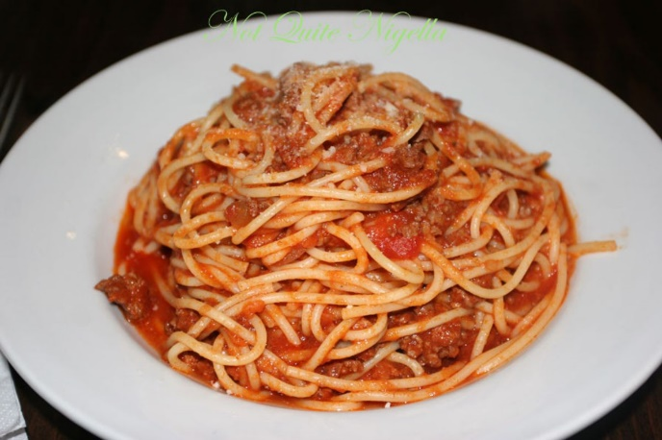
Question
In 1968, Edsger Dijkstra had a letter published in ”Communications of the ACM” with the title “Go To Statement Considered Harmful”
In 2020, How many goto statements are there in the Linux source code (for a recent kernel version)?
Green = less than 180,000
Red = greater than 180,000

Slide 22
Answer
Green = less than 180,000
There are 168764 goto statements in the 5.8-rc2 kernel according to:
‘find . –name “*.[chS]” | xargs grep "[^_a-z]goto +[a-zA-Z0-9_]*;" | grep -v "/[*].*goto" | wc -l‘
Some notes:
Dijkstra did not give his letter the “considered harmful” name. Niklaus Wirth did.
See the paper “gotos considered harmful considered harmful” CACM March 1987 by Frank Rubin for one rebuttal
Arguments (including by Linus Torvalds) in favor of some uses of gotos: https://koblents.com/Ches/Links/Month-Mar-2013/20-Using-Goto-in-Linux-Kernel-Code/

Slide 23

Question
The papers and notes from Edsger Dijkstra’s career are housed in Austin, Texas.
Green = True
Red = False

Slide 24
Answer
Green = True
Dijkstra’s last job was in the computer science department at the University of Texas at Austin
The online E.W. Dijkstra Archive is here:
http://www.cs.utexas.edu/users/EWD/

Slide 25
Question
The warning against lines that are too long for Linux source contributions was recently changed from its old value to 120 columns.
Green = True
Red = False

Slide 26
Answer
Red = False
Checkpatch.pl was modified so the warning occurs at 100 character line length (not 120)
However:
80-chars max is still preferred
See_https://www.phoronix.com/scan.php?page=news_item&px=Linux-Kernel-Deprecates-80-Col
Extrapolating from the timing of this change, we should see the limit expanded to 120 chars on March 9, 2049!

Slide 27
Question
In the 4.x series of Linux kernels, was it possible to configure an ARM kernel smaller than 700,000 bytes (text, data, and bss)?
Green = Yes
Red = No

Slide 28
Answer
Green = Yes
According to a presentation at ELC 2017, Michael Opdenacker built a kernel with a footprint of under ~600,000 bytes
Source:
https://elinux.org/images/0/07/Opdenacker-embedded-linux-size-reduction-techniques.pdf
(graph on slide 16)

Slide 29
Question
Linus said in his keynote session that much work in operating systems is based on principles from the 1960’s. What did he mention as one technology that might require new ideas in the kernel?
Green = Quantum computing
Red = Artificial Intelligence

Slide 30
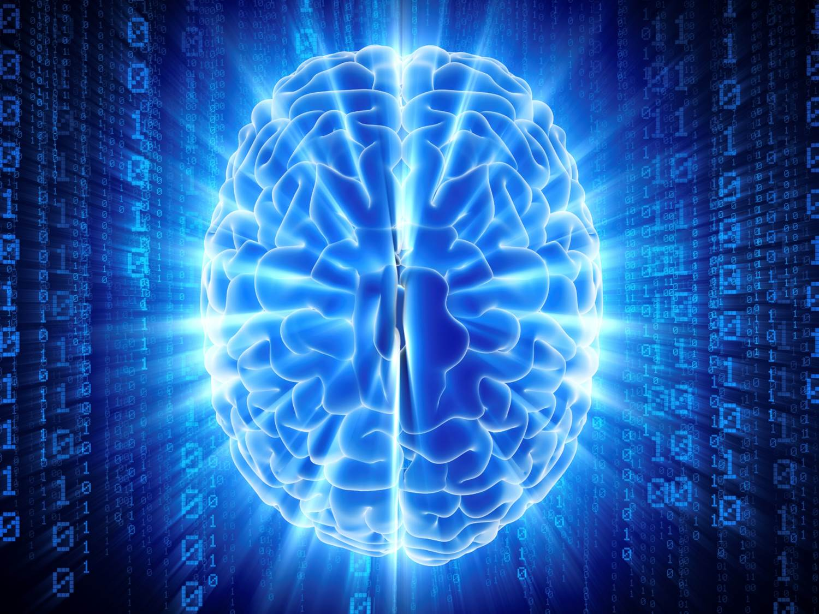
Question
Red = Artificial Intelligence
Linus mentioned AI.

Slide 31
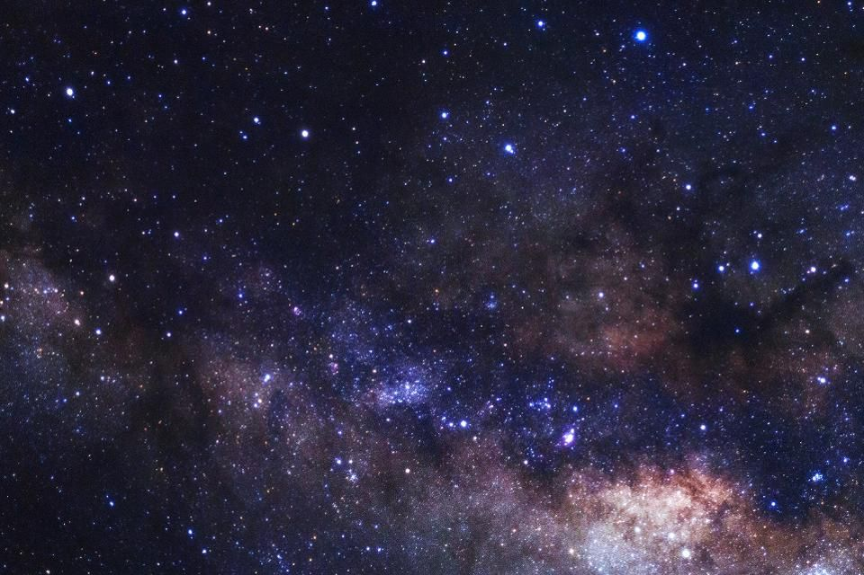
Answer
It is estimated that how many Linux-based computers are currently in outer space? (counting inter-planetary probes)
Green = less than about 65
Red = more than about 65

Slide 32
Question
Red = more than about 65
There are currently over 32,000 computers in space running Linux. Each SpaceX launch of Starlink satellites adds another 4000 or so. Each Starlink satellite includes over 60 Linux computers.
It is estimated that in a few years, there will be 2 million Linux computers in low earth orbit.
Sources:
https://zd.net/30kdr4y
Reddit SpaceX Q&A https://old.reddit.com/r/spacex/comments/gxb7j1/we_are_the_spacex_software_team_ask_us_anything/
I propose that we call this system “SkyNet” when it is complete. ☺

Slide 33
Question
It will be hard to use a Nexus 4 Android phone in the year 2040.
Green = True
Red = False

Slide 34
Answer
Green = True
Android in that era was subject to the “year-2038” bug, where 32-bit UNIX time rolls over.
Luckily, year-2038 problems have mostly been fixed in the kernel, due to a lot of hard work by Arnd Bergmann and others.
Sources:
https://elinux.org/images/6/6e/End_of_Time_--_Embedded_Linux_Conference_2015.pdf (slide 3)
https://www.reddit.com/r/Android/comments/16vci0/heh_you_can_crash_android_with_the_2038_unix_bug/

Slide 35
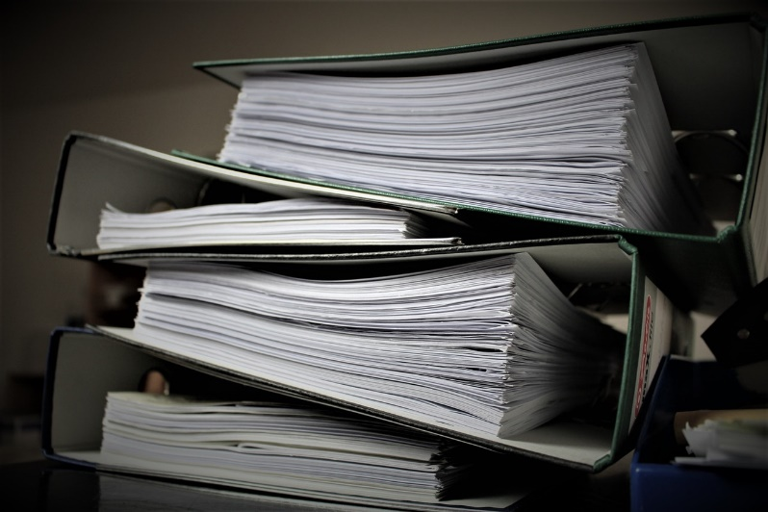
Question
The Linux Foundation kernel documentation team recently added how many new people?
Green = less than 2
Red = more than 6

Slide 36
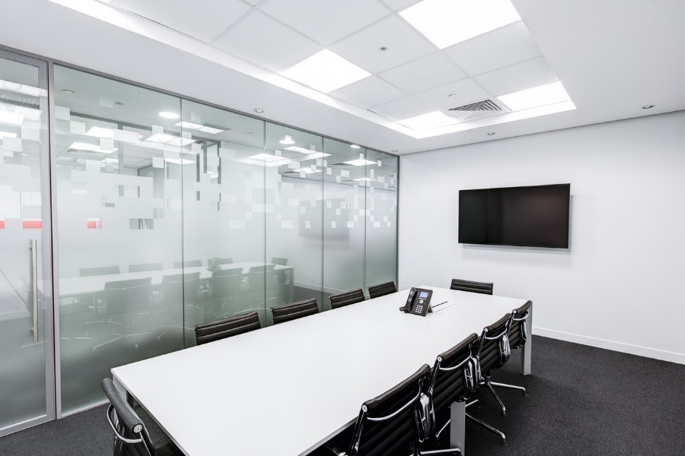
Question
Green = less than 2
The Linux Foundation does not, to my knowledge, have a kernel documentation team.
The LF kernel doc team

Slide 37
Question
In April, an educational computer kit based on the Raspberry PI 4 was released, that was built and marketed by an 11-year old child.
Green = True
Red = False

Slide 38
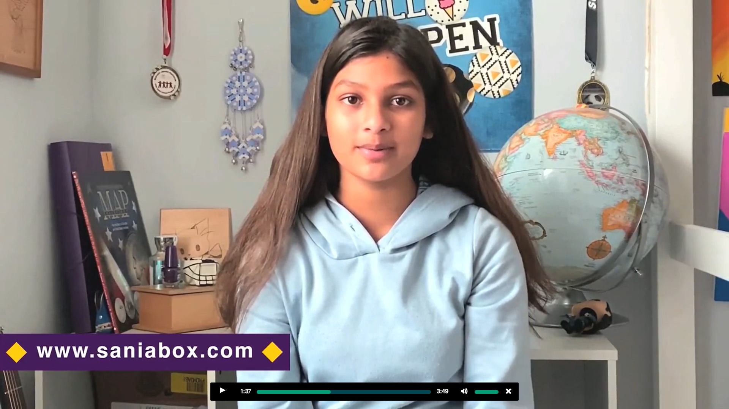
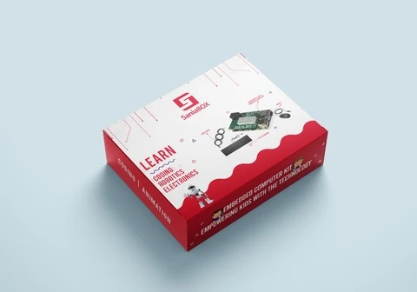
Answer
Red = False
The Sania Box embedded computer kit did go on sale recently, based on a kickstarter campaign. But it was designed and is being sold by a 13-year old young woman from India, named Sania Jain.
Sources:
http://linuxgizmos.com/teen-launches-raspberry-pi-4-based-stem-kit/
The kit includes a Raspberry Pi 4 board and custom shield with multiple sensors, relay, pushbutton, LEDs, 7-segment display, and is targeted at the STEM education market.
I kind of feel like I wasted my youth, by comparison...

Slide 39
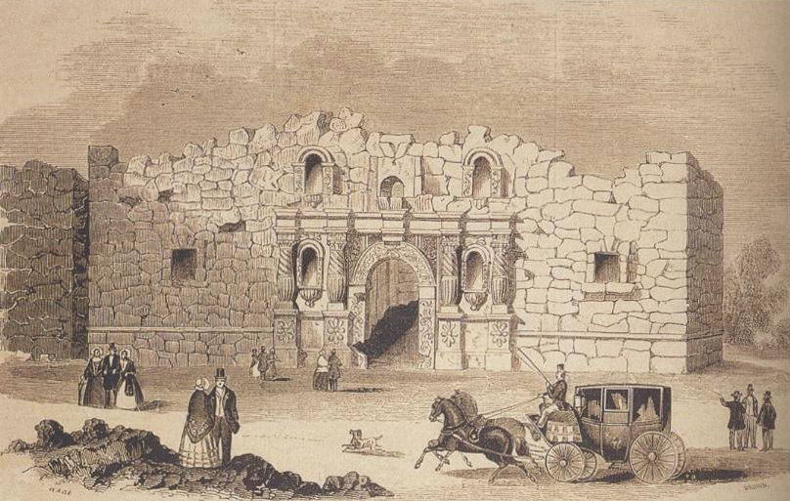
Question
“Remember the Alamo”. Unfortunately we will be missing out on the opportunity to visit one of the most historic sites of Austin, Texas - The Alamo.
In what year was the famous “Battle of Alamo” fought in Austin?
Green = 1836
Red = 1841
Red and Green = Neither of those years

Slide 40
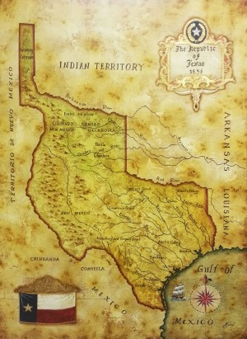
Answer
Red and Green = Neither of those years
The battle of Alamo was fought in 1836, but the Alamo Mission is located in San Antonio Texas, not Austin.

Slide 41
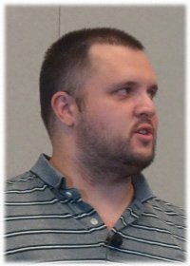
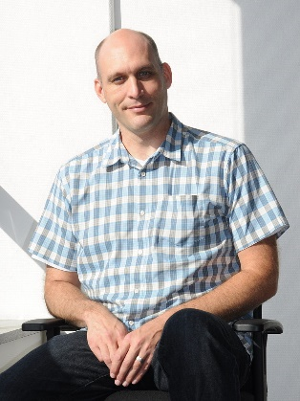
Question
What is the best (recent) evidence that Sasha Levin and Greg Kroah-Hartman have lost their minds?
Green = They wrote a new event notification system for the kernel
Red = They increased the LTS support lifetime
Greg KH photo By Sebastian Oliva - Own work flickr.com/photos/tian2992/6208491794, CC BY-SA 3.0, https://commons.wikimedia.org/w/index.php?curid=16516302 Sasha Levin photo By LWN.net

Slide 42
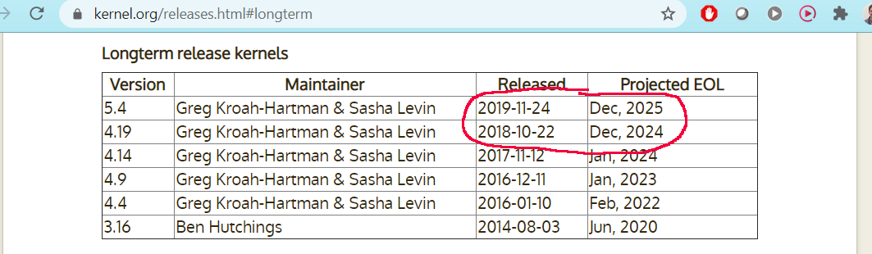
Question
Red = They increased the LTS support lifetime
There is a new event notification system, but that was added by David Howells. Greg and Sasha have increased the support timeframe for 2 (more) LTS kernels from 2 years to 6 years !!
I really don’t know how they do it.

Slide 43
Question
What was the first commercial embedded Linux distribution?
Green = MontaVista Hard Hat Linux
Red = Timesys Linux
Red and Green = Lineo Embedix

Slide 44
Answer
Red and Green = Lineo Embedix
Here are the release dates for each system:
Lineo Embedix 1.0 – January 24, 2000
MontaVista Hard Hat 1.0 – January 31, 2000
Timesys Linux/RT 1.0 – May 16, 2000
Embedded Linux is effectively 20 years old this year!
I think I’m going to declare 2020 as the “Year of Embedded Linux”

Slide 45
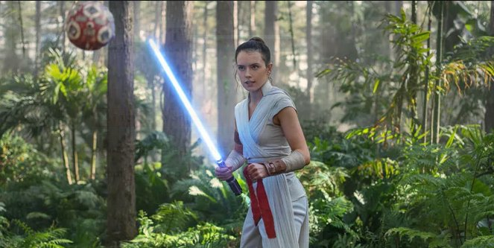
Question
In “The Rise of Skywalker”, Rey continues her training under which Jedi:
Green = Leia Organa
Red = Plo Koon

Slide 46
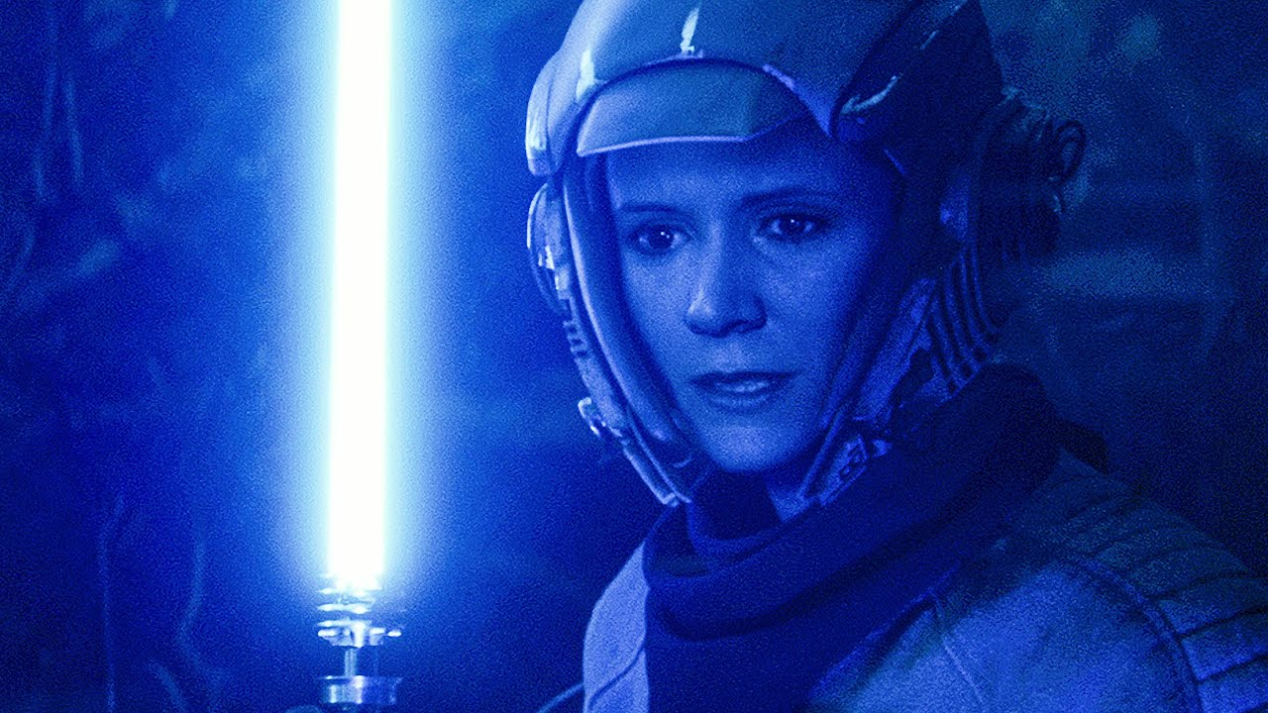
Answer
Green = Leia Organa
Leia trains Rey to become a full-fledged Jedi.
Also, in some brief footage, we see Leia’s own Jedi training with Luke.
Sorry if that was a spoiler for you!

Slide 47

Question
The Yocto Project has its roots in the RPM package management system.
Green = True
Red = False

Slide 48
Answer
Red = False
BitBake, the YP build tool, was originally inspired by Portage, which is the package management used by Gentoo Linux (not RedHat)
Source:
https://en.wikipedia.org/wiki/BitBake

Slide 49
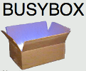
Question
BusyBox was initially created for MMU-less systems (uClinux)
Green = True
Red = False

Slide 50
Answer
Red: False
BusyBox was created for Debian boot floppies
Source:
https://en.wikipedia.org/wiki/BusyBox

Slide 51
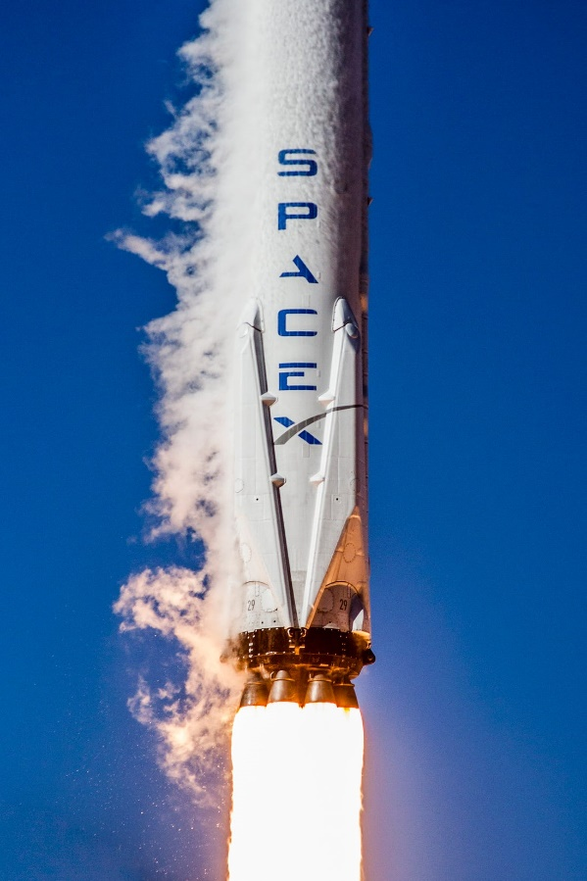
Question
What embedded Linux build system does SpaceX use?
Green = Yocto Project
Red = Buildroot
Red and Green = An in-house build system

Slide 52
Answer
Red: Buildroot
Source:
Reddit SpaceX Q&A https://old.reddit.com/r/spacex/comments/gxb7j1/we_are_the_spacex_software_team_ask_us_anything/

Slide 53
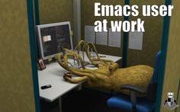
Question
According to the Debian popularity contest, what text editor is more popular?
Green = Vim
Red = Emacs
Red and Green = Nano

Slide 54
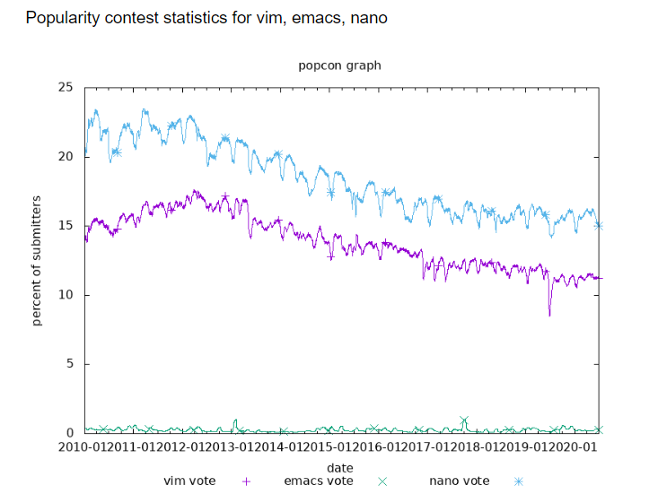
Answer
Red and Green = Nano
Source:
https://qa.debian.org/popcon-graph.php?packages=vim%2C+emacs%2C+nano&show_vote=on&want_percent=on&want_legend=on&want_ticks=on&from_date=2010-01-02&to_date=2020-06-29&hlght_date=&date_fmt=%25Y-%25m&beenhere=1

Slide 55

Question
About how many of the “Reported-by” credits for bugfix patches in the 5.6 kernel are for automated testing systems?
Green = about 20%
Red = about 35%
Red and Green = about 45%

Slide 56
Answer
Red = about 35%
The top 3 “reported-by” lines for bugfixes in v5.6 are for automated testing systems.
Source:
https://lwn.net/Articles/816162/
Test system | Reported-bys | Percent
Hulk Robot | 178 | 18.6%
Syzbot | 99 | 10.4%
kbuild test robot | 58 | 6.1%
I, for one, welcome our new automated testing overlords.

Slide 57

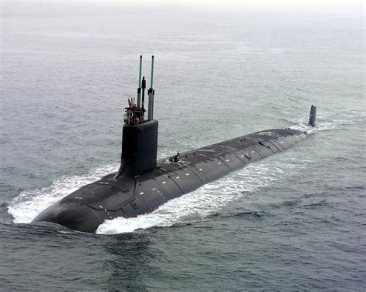
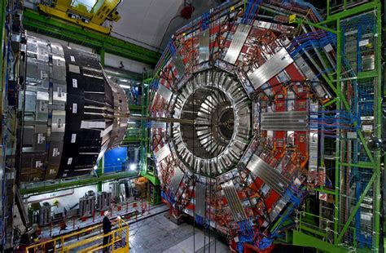
Question
Which of the following is NOT running the Linux kernel:
Green = Mars Opportunity Rover
Red = US Nuclear submarines
Red and Green = Large Hadron Collider

Slide 58
Answer
Green = Mars Opportunity Rover
The rover runs VxWorks
Sources:
https://www.linuxjournal.com/article/7789
https://www.omgubuntu.co.uk/2016/08/25-awesome-unexpected-things-powered-linux
https://www.computerworld.com/article/2563630/mars-rovers-get-long-distance-os-updates.html

Slide 59
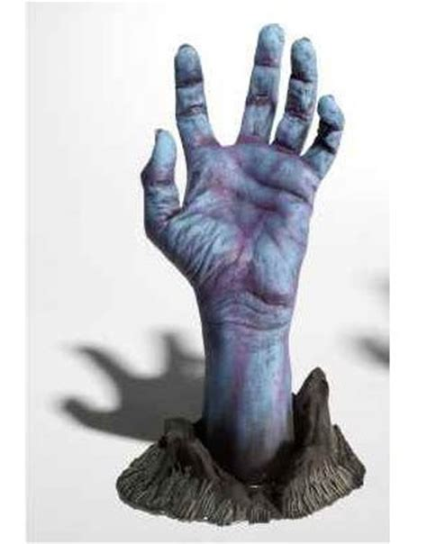
Question
A significant security exploit in the “spectre” family is called what?
Green = Zombieland
Red = Zombieload Attack

Slide 60
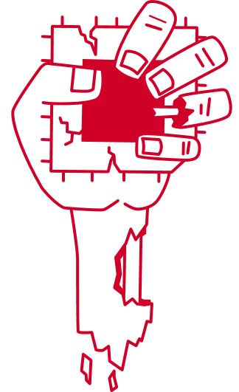

Answer
Red = Zombieload Attack
ZombieLand is a movie
≠

Slide 61
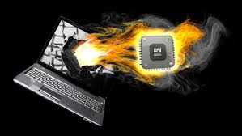
Question
Can the Linux scheduler can take into account the thermal status of a processor?
Green = Yes
Red = No

Slide 62
Answer
Green = Yes
As of kernel v5.7, there is a new “Thermal Pressure” API and thermal governors in the kernel, which can help shift processing from overheated CPUs.
Source:
http://lwn.net/Articles/788380

Slide 63
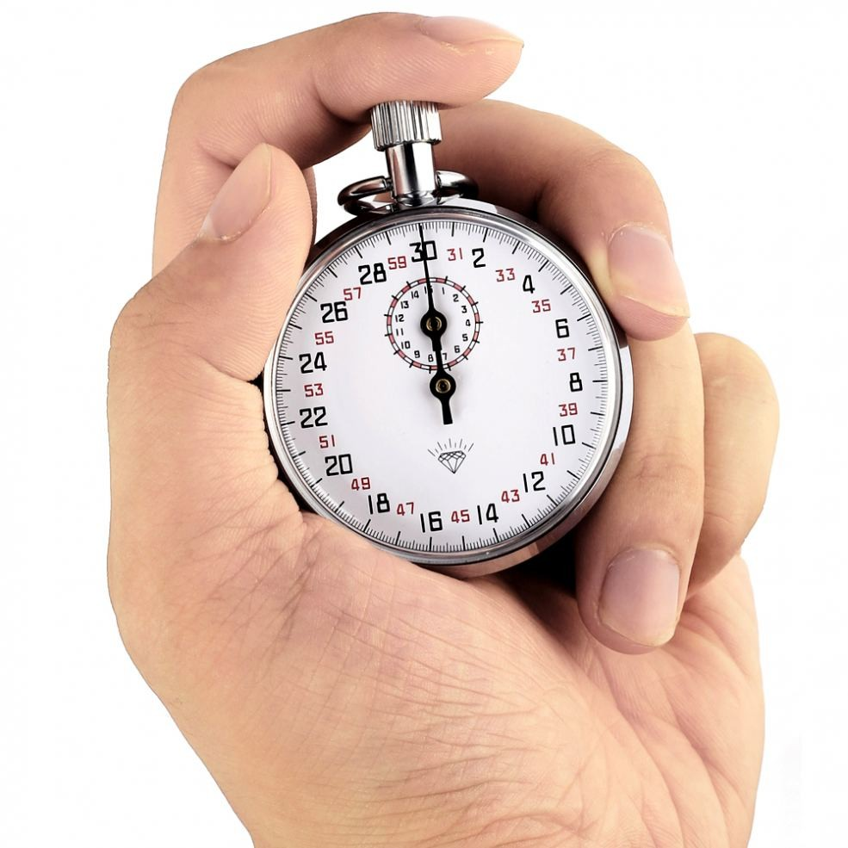
Question
After 13 long years out-of-tree, the PREEMPT_RT patch set is now poised to be accepted into mainline. The initial kconfig entry has already been accepted.
Green = True
Red = False

Slide 64

Answer
Green = True
The kconfig entry for PREEMPT_RT was added in the 5.3 kernel. See kernel/Kconfig.preempt.

Slide 65
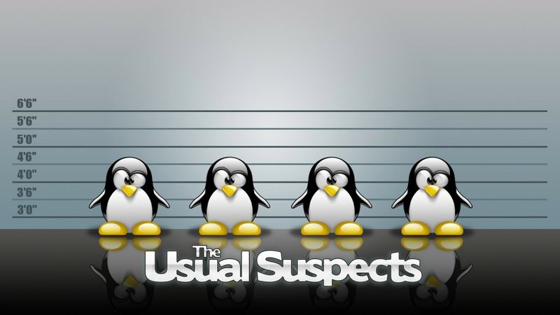
Question - 33
Despite being bitten by a penguin, Linus Torvalds likes penguins.
Green = True
Red = False

Slide 66

Answer
Green: True
Linus was bitten by a penguin
in 1993 while in Australia for a
speaking engagement. But he’s OK with them now.
Source:
https://fossbytes.com/why-is-the-penguin-tux-the-official-mascot-of-linux-because-torvalds-had-penguinitis/

Slide 67
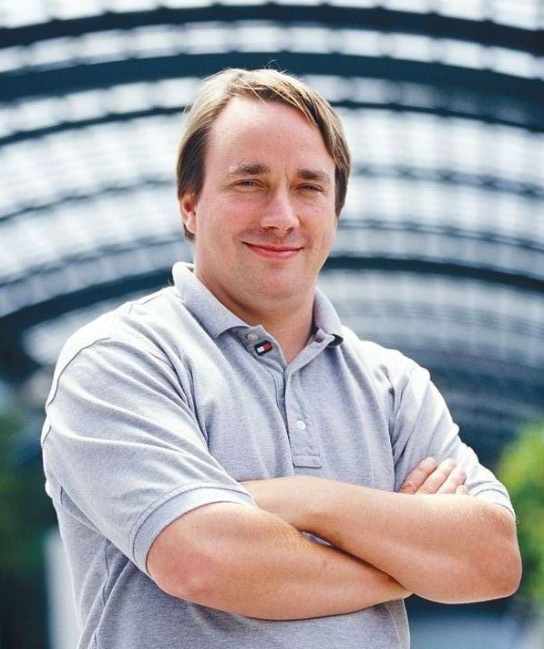
Question
Linux was first called:
Green = Linus’ Unix
Red = Freax

Slide 68
Answer
Red = Freax
Yeah. Really.
Source:
https://en.wikipedia.org/wiki/History_of_Linux
And to think, we could have had an “Embedded Freax Conference”

Slide 69
Question
Which of the following quotes did Rusty Russel have in his e-mail signature?
Green = “There are those who do and those who hang on and you don't see too many doers quoting their contemporaries. -- Larry McVoy”
Red = “Anyone who quotes me in their sig is an idiot. -- Rusty Russell”

Slide 70
Answer
Red or Green!
Both answers are acceptable. Rusty has had both of these as his signatures at different times.

Slide 71
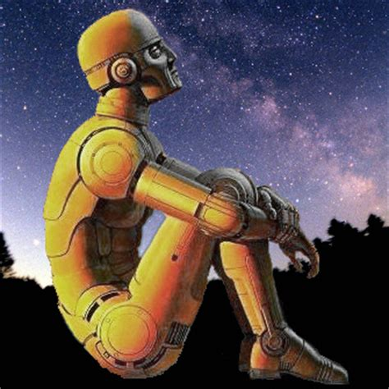
Question
What noted science fiction author created the 3 laws of robotics?
Green = Arthur C. Clark
Red = Isaac Asimov
Red and Green = John W. Campbell

Slide 72
Answer
Red = Isaac Asimov or
Red and Green = John W. Campbell
Isaac Asimov attributed the Three Laws to John W. Campbell, from a conversation that took place on 23 December, 1940. But I can’t exclude Asimov from the answer.
Source:
https://en.wikipedia.org/wiki/Three_Laws_of_Robotics

Slide 73

Question
Microsoft has begun shipping the Linux kernel to many of their Windows customers.
Green = True
Red = False

Slide 74
Answer
Green = True
Microsoft’s Windows Subsystem for Linux (WSL) version 2 includes a “real” Linux kernel, and can be used to run Linux apps on Windows 10.
Source:
https://www.howtogeek.com/424886/windows-10s-linux-kernel-is-now-available/

Slide 75

Question
The Linux Foundation has become the home to many open source projects. How many LF projects are there currently?
Green = about 120
Red = about 180

Slide 76
Answer
Red = about 180
It’s hard to count, since new projects are created regularly.
There are 177 projects listed here: https://www.linuxfoundation.org/projects/directory/
and there are some I’m aware of that are not listed.

Slide 77
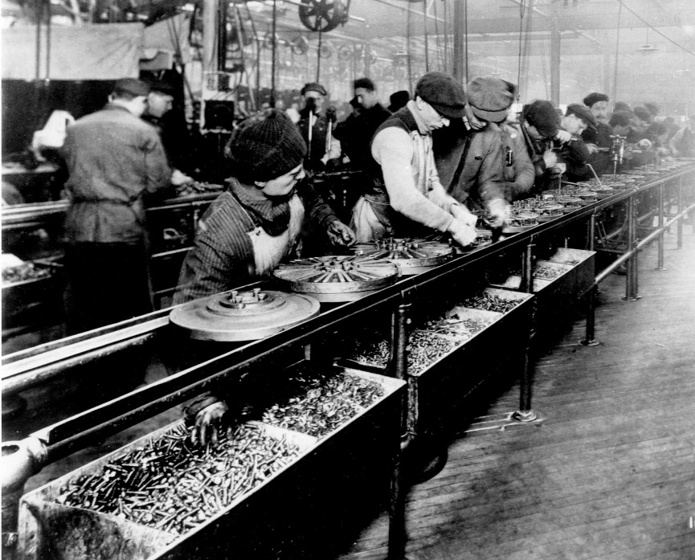
Question
On average, how many patches per hour were contributed to the Linux 5.7 release?
Green = about 9
Red = about 12

Slide 78
Answer
Green = about 9
The actual patches-per-hour for 5.7 was: 9.2 per hour. This was a little less than the max of 9.7 for kernel version 4.9.
Source:
https://github.com/gregkh/kernel-history/blob/master/kernel_stats.ods

Slide 79
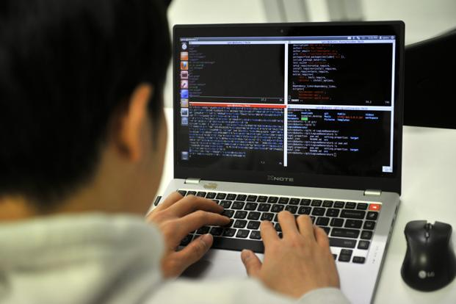
Question
Who has the most code in the linux kernel?
Green = Linus Torvalds
Red = Alex Duecher
Red and Green = Hawking Zhang

Slide 80
Answer
Red = Alex Duecher
According to cregit for 5.7, it is Alex. Linux said he doesn’t do much programming anymore (he’s more like a manager), and even these stats for pre-git probably include lots of source from other people.
Source:
https://cregit.linuxsources.org/code/5.7/
Author | Tokens | Percent
Alex Deucher | 4548031 | 4.20%
Linus Torvalds (pre-git) | 3484706 | 3.22%
Hawking Zhang | 1326778 | 1.22%

Slide 81
Game 1 over Time for Game 2

Slide 82
Our Second Game
Rock, Paper, Scissors
- against Tim’s web script

Slide 83

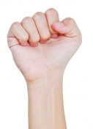
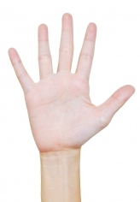
Rules
Rock beats scissors
Scissors cuts paper
Paper covers rock
If you beat the presenter you stay in the game.

Slide 84
Let’s begin
Back to the web site!
https://closinggame.net/rg

Slide 85
Game 2 over Time for some closing thoughts...

Slide 86
Recent Events
It has been an interesting year so far...

Slide 87
Observations
Between COVID-19 and civil unrest, there has been a lot to think about.
On Sunday, a wildfire near my home resulted in the evacuation of 12,000 people
Including me, the day before ELC started

Slide 88
Observations
Very sobering to make split-second decisions about what to take and leave behind
Leaving 99.9% of my belongings entrusted to fire and police protection in my absence
Very grateful for first responders, who sacrificed for my well-being

Slide 89
Observations
In favor of reforms to address injustice
Need to be careful to seek reforms in a way that does not diminish our respect and gratitude for many, many good public servants

Slide 90
Observations
One of the best things I saw on the subject of race relations was this:
Statement by the National Association for the Advancement of Colored People and the Church of Jesus Christ of Latter-day Saints
Do an act of service for someone unlike yourself
“We ... invite people of goodwill everywhere to look for ways to reach out and serve someone of a different background or race. Everyone can do something.”

Slide 91
Link to statement:
https://medium.com/@Ch_JesusChrist/locking-arms-for-racial-harmony-in-america-2f62180abf37

Slide 92
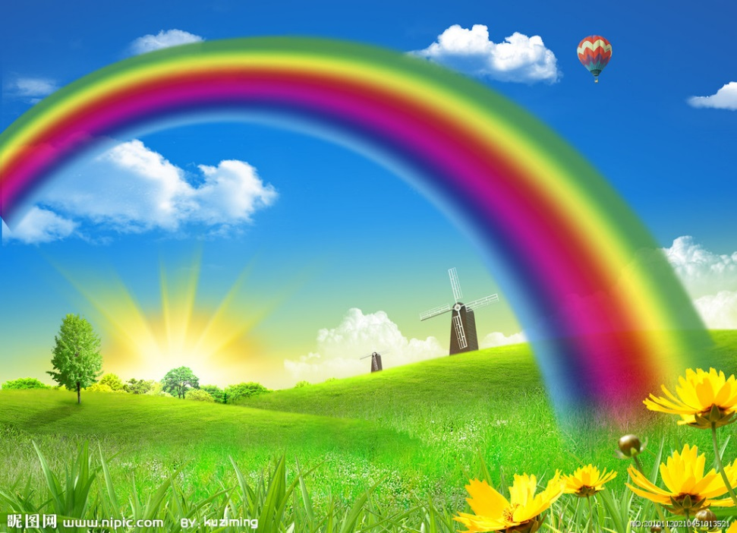
Making things better
Open Source attracts some people as a way to contribute to greater good in the world.
While you’re out there coding, don’t forget to also reach out and serve others

Slide 93
Thanks for joining!
Hope you learned something new, and had a good time.
Hope to see you next year!

